Slide 1

Predicting Term Deposit Subscription: Analysis of Bank Marketing Campaign Data
GROUP E:
RAHULKUMAR DAS
DON WIGINGTON
MADHAV VEMPATY
NEERAJA VEDULLA

Slide 2
Problem Definition
Our objective is to determine the key factors that influence term deposit subscriptions in a Portuguese banking institution's direct marketing campaigns. By analyzing the Bank Marketing Dataset, we aim to develop insights and strategies to enhance subscription rates and optimize marketing efforts, ultimately improving the bank's overall performance
Problem Definition

Slide 3

Our goal is to identify factors influencing term deposit subscriptions in a Portuguese bank's marketing campaigns, using the Bank Marketing Dataset, to enhance subscription rates and campaign effectiveness.

Slide 4
Methodology
Setting Business Goals
Model Evaluation
Model Implementation
Data Understanding
Developing Statistical Model
Predicting target Variable
Data Preprocessing
Exploratory Data Analysis
Optimizing Business Strategies

Slide 5
Numerical features | Categorical features
Age | Job
Balance | Marital
Day | Education
Duration | Default
Campaign | Housing
Pdays | Loan
Previous | Contact
 | Month
 | Poutcome

Slide 6
Job Categories
Marital Status
Educational levels
Contact Method
Financial Stability
Previous Campaign Outcome
Key Features

Slide 7
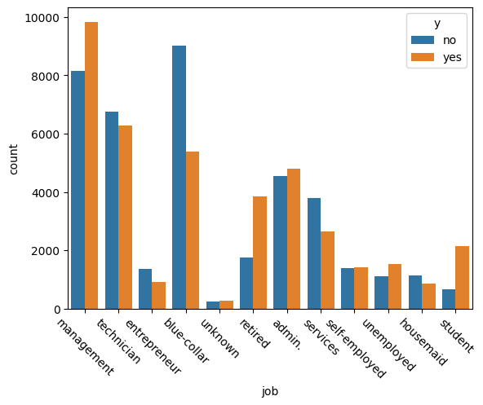
Job Categories VS Target Variable
Insights:
Blue collar workers had Lowest conversion rate, indicating an opportunity for targeted marketing strategies.
Management and Students have high subscription rates.

Slide 8
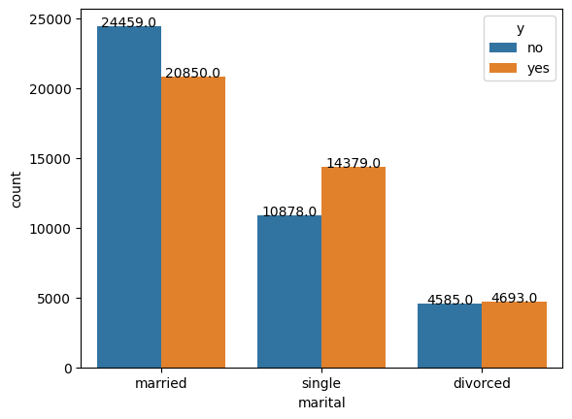
Marital Status VS Target Variable
Insights:
Single people are subscribing to more Term Deposits compared to single and divorced people.
Tailored strategies are needed to improve the conversion rates among married people.

Slide 9
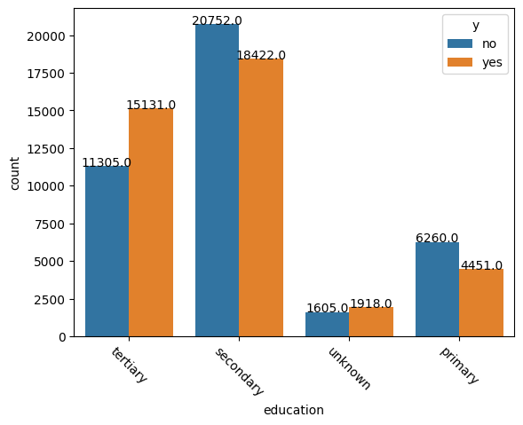
Education VS Target Variable
Insights:
Post secondary has higher subscription rates.
Tailoring marketing and educational strategies for a broader audience in secondary and tertiary to encourage deposit subscriptions would increase profits.

Slide 10
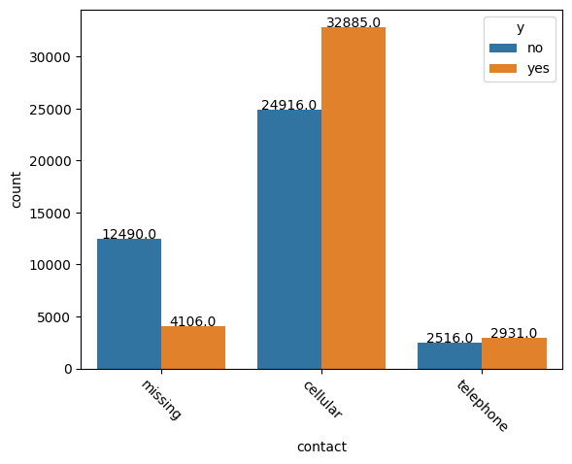
Contact Method VS Target Variable
Insights:
Cellular communication leads to higher subscription rates, suggesting the need to focus on mobile outreach.
Subscriptions are lower via traditional phone contact, indicating the importance of optimizing phone-based marketing strategies.

Slide 11
MODEL SCORES
 | DECISION TREE | KNN | RANDOM FOREST | XG BOOST
ACCURACY | 0.95 | 0.92 | 0.96 | 0.91
RECALL | 1.00 | 1.00 | 1.00 | 0.95
PRECISION | 0.91 | 0.87 | 0.93 | 0.87
F1 SCORE | 0.95 | 0.93 | 0.96 | 0.91
AUC | 0.95 | 0.95 | 1.00 | 0.96

Slide 12
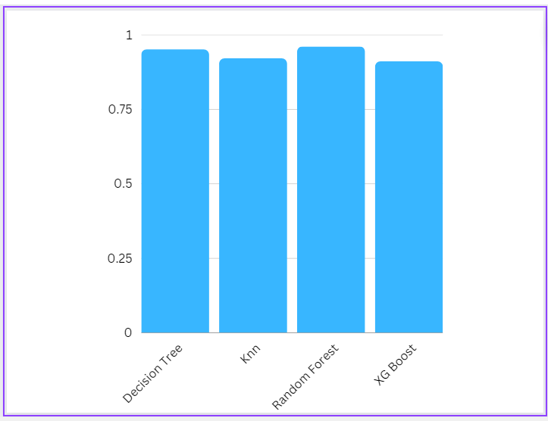
MODEL ACCURACIES

Slide 13

Our data analysis has unveiled crucial insights across job categories, marital status, education, financial stability, contact methods, and campaign outcomes.
Tailoring strategies to specific customer segments and deploying predictive models, notably the Random Forest with a high F1 score and 96% accuracy, is essential for marketing success.
This data-driven approach ensures not only immediate campaign effectiveness but also long-term customer satisfaction and loyalty, providing a robust foundation for sustainable growth and profitability in the dynamic banking sector.

Slide 14
Strategies and Recommendations for Marketing Optimization
Segmented Marketing: Develop tailored marketing campaigns for different job categories. Focus on management roles and students, and consider specialized strategies for blue-collar workers.
Marital Status Targeting: Create targeted campaigns for married customers, addressing their specific needs and preferences, to enhance conversion rates.
Educational Outreach: Design marketing and educational strategies that cater to customers with tertiary education, offering them products and services aligned with their financial goals.
Creditworthiness Focus: Prioritize customers without defaulted loans, housing loans, and personal loans. Consider offering financial products that reward and support good credit scores and financial stability.
Communication Channel Enhancement: Shift resources towards cellular communication for customer outreach, as it has demonstrated higher subscription rates compared to telephone contact.
Leverage Previous Success: Continue to engage and nurture customers who had a successful outcome in previous campaigns, as they are more likely to subscribe to term deposits.

Slide 15
Thank You

